Slide 1


AVOP Sub-award Closeout:

Slide 2

Overview of Closeout
Notes:
2 CFR 200, subpart E

Slide 3
General Guidance
Project Closeout
Recommend to end project activities (i.e. assignments) 30-60 days before end date to allow sufficient time to conduct impact assessments and closeout activities
Terminate any vendor or subrecipient contracts with sufficient time to ensure final invoice payments are issued by or before award end date
Start developing a closeout plan and timeline
Notes:
We’re going to go over the federal definitions and review non-construction procurement (most relevant to our operations). The POA policies set lower thresholds for procurements for field offices.
If you are interested in advancing in your work in USG-funded international development activities, being familiar with 2 CFR 200 in general, and knowing the key terms to mention in an interview for example, can make you more competitive in the job market.
Detailed record of procurement process:
Rationale for method of procurement
Selection of contract type
Contractor selection or rejection
Cost and price analysis to determine price

Slide 4
Financial Requirements
Notes:
2 CFR 200, subpart E

Slide 5
Final VAT Report
Financial Closeout
Entities that purchased $500 USD or more worth of commodities with USG funds or paid any customs duties in the country where it is operating during the prior fiscal year is required to submit report
Report required even if entity did not pay taxes on items purchased – serves to confirm no (exempted) taxes were paid
Report due to UTK within 30 days of award end date
Covers October 1, 2022 to August 31, 2023
Notes:
We’re going to go over the federal definitions and review non-construction procurement (most relevant to our operations). The POA policies set lower thresholds for procurements for field offices.
If you are interested in advancing in your work in USG-funded international development activities, being familiar with 2 CFR 200 in general, and knowing the key terms to mention in an interview for example, can make you more competitive in the job market.
Detailed record of procurement process:
Rationale for method of procurement
Selection of contract type
Contractor selection or rejection
Cost and price analysis to determine price

Slide 6
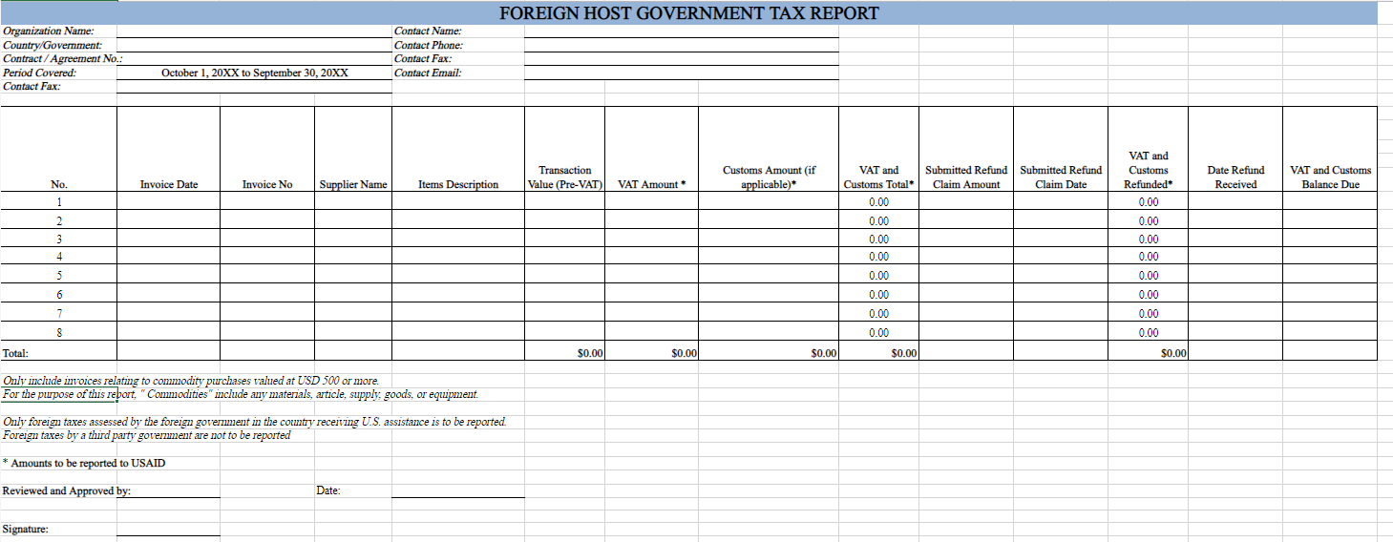
Final VAT Report
Notes:
We’re going to go over the federal definitions and review non-construction procurement (most relevant to our operations). The POA policies set lower thresholds for procurements for field offices.
If you are interested in advancing in your work in USG-funded international development activities, being familiar with 2 CFR 200 in general, and knowing the key terms to mention in an interview for example, can make you more competitive in the job market.
Detailed record of procurement process:
Rationale for method of procurement
Selection of contract type
Contractor selection or rejection
Cost and price analysis to determine price

Slide 7
Disposition Plan
Administrative Closeout
Send inventory list to UTK
In email to UTK confirm no equipment (over $5,000 USD) was purchased under the second-tier subaward
In email confirm that Ce Sain will retain all supplies (valued below $5,000 USD)
Notes:
We’re going to go over the federal definitions and review non-construction procurement (most relevant to our operations). The POA policies set lower thresholds for procurements for field offices.
If you are interested in advancing in your work in USG-funded international development activities, being familiar with 2 CFR 200 in general, and knowing the key terms to mention in an interview for example, can make you more competitive in the job market.
Detailed record of procurement process:
Rationale for method of procurement
Selection of contract type
Contractor selection or rejection
Cost and price analysis to determine price

Slide 8
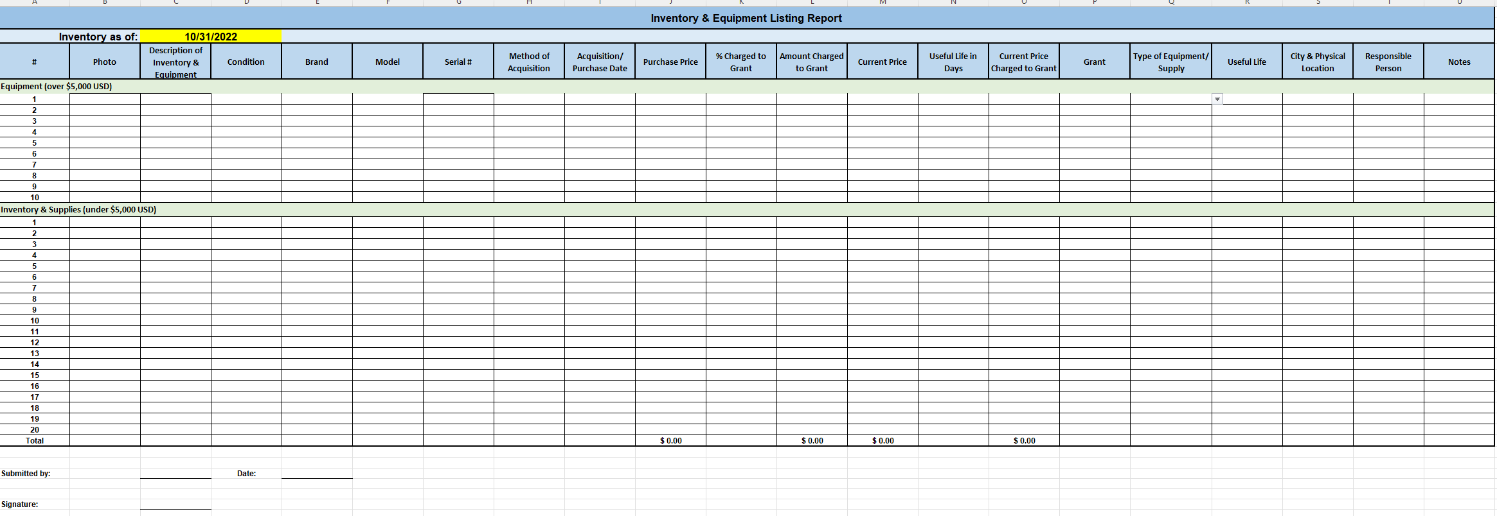
Inventory List Example
Notes:
We’re going to go over the federal definitions and review non-construction procurement (most relevant to our operations). The POA policies set lower thresholds for procurements for field offices.
If you are interested in advancing in your work in USG-funded international development activities, being familiar with 2 CFR 200 in general, and knowing the key terms to mention in an interview for example, can make you more competitive in the job market.
Detailed record of procurement process:
Rationale for method of procurement
Selection of contract type
Contractor selection or rejection
Cost and price analysis to determine price

Slide 9
Administrative Requirements

Slide 10

Administrative Closeout
Pre-Award Ending
Ensure compliance with USAID standards on the types of documents that need to be retained
Terminate leases on rented office space, supply contracts, utilities, other service providers (phone plans, insurance, security, etc.)
Document vendor notice of termination(s)
Charges for services provided beyond project end date are not allowed

Slide 11
Administrative Closeout
Post-Award Ending
Record Retention
Maintain all project documents and accounting records in accordance with award terms and local laws
Minimum retention requirement of 3 years from the date of submission of the final expenditure report
USAID reserves right to audit your project/organization at any point within these 3 years
Subrecipients must also abide by same record retention requirements, including local country laws

Slide 12
Human Resource Closeout
Pre-Award Ending
Develop staff transition plan
Modify employee contracts to reflect the project closeout date and update job descriptions
Follow any prior notices required by law
Plan for proper accrual of fringe benefits under the project:
Identify and understand local payment requirements related to severance and other benefits as defined by law
Understand organizational payment requirements
Clear any staff outstanding advances

Slide 13
Human Resource Closeout
Post-Award Ending
Document staff terminations and final salary and benefits payments
Securely maintain HR files related to each staff member
Collect and document company or project property returned by staff members
Clear any sensitive employee information from laptops, cellphones, etc.

Slide 14
Final Narrative Report

Slide 15
Final Narrative Report
Programmatic Closeout
POA will provide specific outline and requirements
However, outline will likely include:
Executive Summary of the completed project
Detailed summary of LOP project activities, results and lessons learned as well as recommendations for future development efforts
Success at accomplishing intermediate results, including a comparison of actual vs. planned accomplishments (as set forth in work plans) and explanation of any shortfalls
Lessons learned
Report due to UTK no later than 30 days after award ends
Notes:
We’re going to go over the federal definitions and review non-construction procurement (most relevant to our operations). The POA policies set lower thresholds for procurements for field offices.
If you are interested in advancing in your work in USG-funded international development activities, being familiar with 2 CFR 200 in general, and knowing the key terms to mention in an interview for example, can make you more competitive in the job market.
Detailed record of procurement process:
Rationale for method of procurement
Selection of contract type
Contractor selection or rejection
Cost and price analysis to determine price

Slide 16
Final Indicator Data Report
Programmatic Closeout
Same format and template as annual data reports
Include LOP data for all assignments and hosts
Impact data is required for ALL hosts
As usual, if an indicator does not apply to a host (i.e. annual sales for government agencies), add a "0" or "-"
There shouldn't be any blank cells or missing impact data for hosts
Report due to UTK no later than 30 days after award ends
Notes:
We’re going to go over the federal definitions and review non-construction procurement (most relevant to our operations). The POA policies set lower thresholds for procurements for field offices.
If you are interested in advancing in your work in USG-funded international development activities, being familiar with 2 CFR 200 in general, and knowing the key terms to mention in an interview for example, can make you more competitive in the job market.
Detailed record of procurement process:
Rationale for method of procurement
Selection of contract type
Contractor selection or rejection
Cost and price analysis to determine price

Slide 17

Q&A

